Slide 1
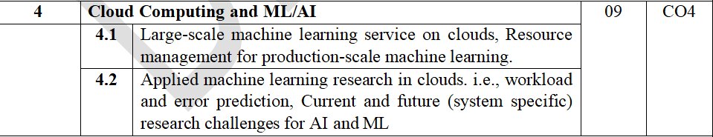
Module 4: Cloud Computing and ML/AI

Slide 2
Large-scale machine learning service on clouds
A large-scale machine learning (ML) service on the cloud is a cloud-based system that provides the computing power, storage, data-processing tools, and ML software needed to train, deploy, and operate machine-learning models on very large datasets.
Instead of purchasing and maintaining powerful servers, organizations use cloud infrastructure that can scale up or down according to workload.

Slide 3
Large-scale machine learning service on clouds
1. Why is cloud needed for large-scale ML?
Traditional ML can be difficult when the dataset and model become very large.
For example:
Dataset = several TB/PB of data
Millions or billions of training records
Complex deep-learning models
Training may require hundreds of CPUs/GPUs
Many users may need predictions simultaneously
Cloud computing provides:
Large storage → Distributed processing → GPU/TPU(Tensor) computing → Model training → Deployment → Predictions

Slide 4
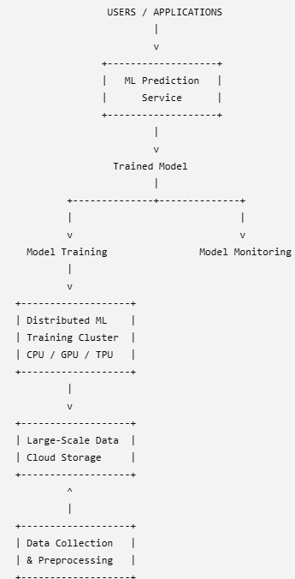
Large-scale machine learning service on clouds
Basic Architecture:

Slide 5
Large-scale machine learning service on clouds
3. Major Components:
A. Data Storage
Large ML systems need to store enormous amounts of data.
Cloud storage can store:
Images
Videos
Text
Sensor data
Customer transactions
Logs
Training datasets
Examples include:
Amazon S3
Google Cloud Storage
Azure Blob Storage
The data can be accessed by many compute nodes.

Slide 6
Large-scale machine learning service on clouds
3. Major Components:
B. Data Preprocessing
Raw data usually cannot be directly given to an ML algorithm.
It must be:
Cleaned
Filtered
Transformed
Normalized
Labeled
Converted into a suitable format
For very large datasets, preprocessing is distributed across multiple machines.

Slide 7
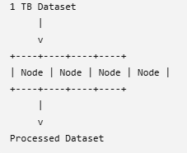
Large-scale machine learning service on clouds
3. Major Components:
B. Data Preprocessing
For Example:
This reduces the time required for preprocessing.

Slide 8
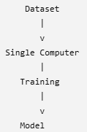
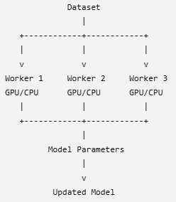
Large-scale machine learning service on clouds
4. Distributed Machine Learning
This is the most important concept in large-scale ML.
Instead of training a model on one machine:
cloud-based ML can use many machines:
Each worker performs part of the computation.

Slide 9
Large-scale machine learning service on clouds
5. Parallel Model Training
Large neural networks may require enormous computational resources.
Cloud platforms provide:
CPUs
GPUs
TPUs
High-speed networking
Distributed memory/storage
For example, suppose training takes:
100 hours on one GPU.
If the workload can be efficiently distributed across 20 GPUs, the theoretical training time could approach:100/20=5 hours
It will usually take longer because of communication and synchronization overhead.

Slide 10
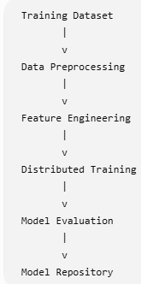
Large-scale machine learning service on clouds
6. Model Training
The cloud ML service provides an environment for training models.
Typical process:
The system may automatically provide the required number of machines and GPUs.

Slide 11
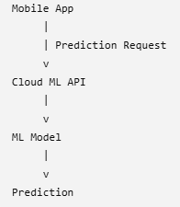
Large-scale machine learning service on clouds
7. Model Deployment
After training, the model is deployed as a service.
For example:

Slide 12
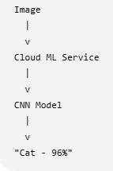
Large-scale machine learning service on clouds
7. Model Deployment
Example:
A user uploads an image:
The application does not need to contain the ML model itself.

Slide 13
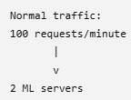
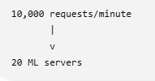
Large-scale machine learning service on clouds
8. Auto Scaling
One of the major advantages of cloud-based ML services is elasticity.
Suppose:
During peak traffic:
The cloud can automatically increase or decrease resources.
This is called auto scaling.

Slide 14
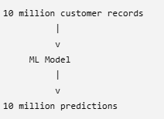
Large-scale machine learning service on clouds
9. Batch Prediction vs Real-Time Prediction
Batch Prediction
Predictions are generated for a large amount of data at once.
Example:
Used for:
Customer analysis
Fraud analysis
Recommendation generation
Large-scale data processing

Slide 15
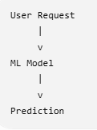
Large-scale machine learning service on clouds
9. Batch Prediction vs Real-Time Prediction
Real-Time Prediction
Prediction is generated immediately after receiving a request.
Example:
Used for:
Fraud detection
Speech recognition
Image recognition
Chatbots
Recommendation systems

Slide 16
Large-scale machine learning service on clouds
10. Fault Tolerance
Large-scale ML may use hundreds or thousands of machines.
Some machines can fail.
Cloud ML systems therefore provide mechanisms such as:
Checkpointing
Task restart
Data replication
Worker replacement
Automatic recovery

Slide 17
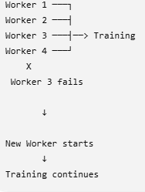
Large-scale machine learning service on clouds
10. Fault Tolerance
For example:
This prevents the entire training job from having to restart.

Slide 18
Large-scale machine learning service on clouds
11. Machine Learning as a Service (MLaaS)
Cloud providers can offer ML capabilities as a service.
This is often called Machine Learning as a Service (MLaaS).
The user does not have to manage:
Physical servers
GPUs
Operating systems
Networking
Storage infrastructure

Slide 19
Large-scale machine learning service on clouds
11. Machine Learning as a Service (MLaaS)
Instead, the user can focus on:
Data
Algorithms
Model training
Evaluation
Application development
Examples of cloud ML platforms include:
Amazon Web Services — SageMaker
Google Cloud — Vertex AI
Microsoft Azure — Azure Machine Learning

Slide 20
Large-scale machine learning service on clouds
12. Advantages
1. Scalability
Resources can be increased when the dataset or workload grows.
2. Cost efficiency
Organizations can use resources when needed instead of purchasing permanent infrastructure.
3. High computational power
Cloud providers offer GPU/TPU-based infrastructure.
4. Large storage
Very large datasets can be stored in cloud object storage.
5. Faster training
Distributed computing allows ML jobs to run across multiple machines.

Slide 21
Large-scale machine learning service on clouds
12. Advantages
6. High availability
Cloud platforms provide redundancy and fault tolerance.
7. Easy deployment
A trained model can be exposed through APIs and integrated with applications.
8. Elasticity
Resources can automatically scale according to demand.

Slide 22
Large-scale machine learning service on clouds
13. Challenges
Large-scale ML on clouds also has some challenges:
Data transfer
Moving huge datasets between locations can be slow and expensive.
Communication overhead
Distributed training requires workers to exchange model parameters.
Cost
GPU and high-performance computing resources can be expensive.

Slide 23
Large-scale machine learning service on clouds
13. Challenges
Large-scale ML on clouds also has some challenges:
Security
Sensitive training data must be protected.
Model management
Many versions of models may need to be stored and monitored.
Resource management
The system must efficiently allocate CPUs, GPUs, memory and storage.

Slide 24
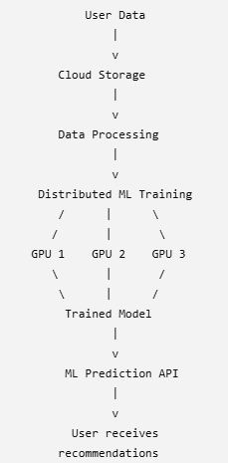
Large-scale machine learning service on clouds
14. Example: Large-Scale Recommendation System
Consider an e-commerce website with 100 million users.
The system collects:
User clicks
Product views
Purchases
Search history
Ratings
These datasets are stored in cloud storage.

Slide 25

Large-scale machine learning service on clouds
14. Example: Large-Scale Recommendation System
When a user opens the website, the ML service might return:
Cloud infrastructure allows the ML system to process huge datasets, train complex models, and serve predictions to a very large number of users.
A large-scale machine learning service on the cloud combines distributed storage, distributed computing, GPUs/TPUs, ML frameworks, scalable model training, and model-serving APIs to build and operate machine-learning applications over massive datasets and workloads.

Slide 26
Resource management for production-scale machine learning
Resource management for production-scale machine learning means efficiently managing the computing, storage, networking, memory, GPUs/CPUs, data, and software resources required to develop, train, deploy, and operate ML models at large scale.
A small ML experiment may run on one laptop. A production ML system may need hundreds or thousands of CPUs/GPUs, terabytes or petabytes of data, and thousands of prediction requests per second.
The goal is to use the right amount of resources at the right time while maintaining performance, reliability, scalability, and reasonable cost.

Slide 27
Resource management for production-scale machine learning
1. Why Resource Management is Important
Consider an ML recommendation system used by an e-commerce website.
Suppose:
50 million users
Millions of products
TBs of training data
100,000 prediction requests per second
Deep-learning model requiring GPUs

Slide 28
Resource management for production-scale machine learning
1. Why Resource Management is Important
If resources are not managed properly, several problems can occur:
Training becomes very slow.
GPUs remain idle.
Memory becomes insufficient.
Prediction latency increases.
Servers become overloaded.
Cloud costs become very high.
System may fail during peak traffic.
Therefore, production ML requires systematic resource management.

Slide 29
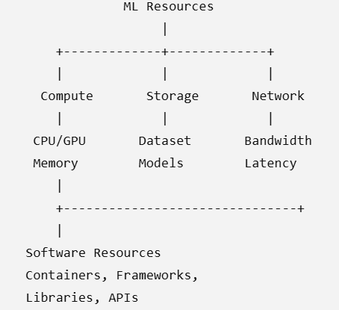
Resource management for production-scale machine learning
2. Types of Resources
There are several important resources in a production ML system.

Slide 30
Resource management for production-scale machine learning
3. Compute Resource Management
Compute resources are the machines used to perform ML operations.
They include:
CPU
GPU
TPU
Memory/RAM
Virtual machines
Containers
Kubernetes clusters
Different ML workloads require different resources.

Slide 31
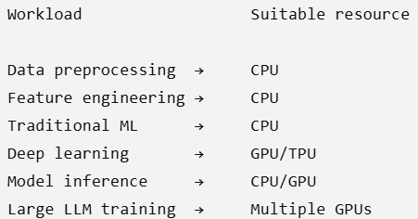
Resource management for production-scale machine learning
3. Compute Resource Management
Example
A traditional ML algorithm such as logistic regression may need mostly CPU.
A deep neural network may require powerful GPUs.

Slide 32
Resource management for production-scale machine learning
3. Compute Resource Management
The goal is to avoid both:
Under-utilization
GPU capacity = 100%
Actual usage = 20%
and
Over-utilization
GPU capacity = 100%
Actual workload = 100%+
The first wastes money; the second causes performance problems.

Slide 33
Resource management for production-scale machine learning
4. CPU Resource Management
CPUs are commonly used for:
Data preprocessing
Feature extraction
Data loading
Model inference
API handling
Scheduling
Monitoring
For example, suppose a training job uses 8 GPUs but only 2 CPU cores for preprocessing.
The GPUs may frequently wait for data.
Better CPU allocation can keep the GPUs continuously supplied with data.

Slide 34
Resource management for production-scale machine learning
5. GPU Resource Management
GPUs are expensive and highly important in deep learning.
A production ML platform must decide:
How many GPUs are required?
Suppose three jobs arrive:Job A → Image classification → 1 GPU
Job B → Large neural network → 4 GPUs
Job C → LLM training → 8 GPUs
The resource manager determines whether enough GPUs are available and allocates them accordingly.

Slide 35
Resource management for production-scale machine learning
5. GPU Resource Management
A production ML platform must decide:
Which GPU type should be used?
Not all GPUs have the same capabilities.
They can differ in:
Computing performance
GPU memory
Memory bandwidth
Energy consumption
Cost
Using a very powerful GPU for a small workload may increase cost without providing much benefit.

Slide 36
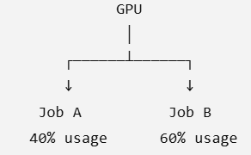
Resource management for production-scale machine learning
5. GPU Resource Management
A production ML platform must decide:
How should GPUs be shared?
A GPU may sometimes be shared among multiple workloads, depending on the platform and workload.
For Example:
Alternatively, a GPU can be dedicated to one job:
GPU 1 → Job A
GPU 2 → Job B
GPU 3 → Job C
Sharing can improve utilization, while dedicated allocation can provide more predictable performance.

Slide 37
Resource management for production-scale machine learning
5. GPU Resource Management
A production ML platform must decide:
Which training job gets priority?
Suppose only 2 GPUs are available but there are three jobs:
Job A → Research experiment
Job B → Production model retraining
Job C → Low-priority experiment
The resource manager may use scheduling policies to determine which jobs run first.
For example:
Priority
↓
High ──→ Job B
Medium → Job A
Low ───→ Job C
The exact priority policy depends on the organization's requirements.

Slide 38
Resource management for production-scale machine learning
5. GPU Resource Management
A production ML platform must decide:
When should GPUs be released?
A GPU should not remain allocated after a job has finished.
For example:
10:00 → Training starts
10:00 → GPU allocated
12:30 → Training finishes
12:30 → GPU released
12:31 → GPU available for another job
If the GPU remains reserved after the job finishes:
GPU allocated
↓
Job finished
↓
GPU still reserved
↓
GPU sits idle
↓
💰 Wasted resources
Therefore, automatic resource release is an important part of GPU management.

Slide 39
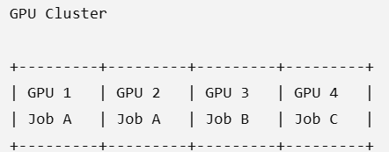
Resource management for production-scale machine learning
5. GPU Resource Management
For example:
If Job A requires two GPUs, the scheduler allocates two GPUs to it.
When Job A finishes:
GPU 1 → Free
GPU 2 → Free
They can be allocated to another job.
This prevents expensive GPU resources from remaining idle.

Slide 40
Resource management for production-scale machine learning
6. Memory Management
ML applications can require very large amounts of memory.
There are several types:
Main memory
RAM used for:
Data preprocessing
Feature engineering
Model loading
Intermediate calculations

Slide 41
Resource management for production-scale machine learning
6. Memory Management
GPU memory
Used for:
Model parameters
Activations
Gradients
Batches
A model may fail if the GPU does not have enough memory.
This is called:
Out Of Memory (OOM)

Slide 42
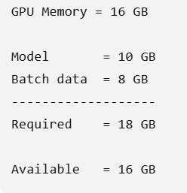
Resource management for production-scale machine learning
6. Memory Management
Example:
The training process may fail.
Resource management can solve this using:
Smaller batch size
Model optimization
Gradient accumulation
Mixed precision
Larger-memory GPUs

Slide 43
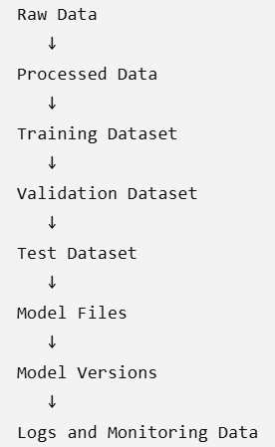
Resource management for production-scale machine learning
7. Storage Resource Management
Production ML systems deal with huge quantities of data.
Storage may contain:

Slide 44
Resource management for production-scale machine learning
7. Storage Resource Management
Cloud object storage is commonly used for large datasets.
Examples:
Amazon S3
Google Cloud Storage
Azure Blob Storage
Important storage considerations
Capacity
Read/write speed
Cost
Data durability
Availability
Access frequency

Slide 45
Resource management for production-scale machine learning
8. Data Management
Data itself is an important resource.
A production ML system may continuously receive:
User data
Sensor data
Transaction data
Images
Videos
Logs
Text
IoT data

Slide 46
Resource management for production-scale machine learning
8. Data Management
The system must efficiently:
Collect data
Store data
Clean data
Transform data
Label data
Partition data
Feed data to ML models
For very large datasets, distributed data processing is used.

Slide 47
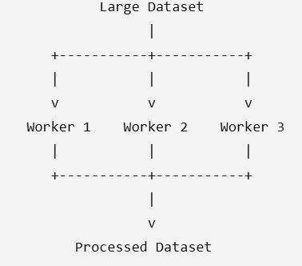
Resource management for production-scale machine learning
8. Data Management

Slide 48
Resource management for production-scale machine learning
9. Network Resource Management
Distributed ML systems require communication between machines.
For example, during distributed training:
GPU 1 ─────┐
GPU 2 ─────┤
GPU 3 ─────┼──> Parameter Synchronization
GPU 4 ─────┘
Large amounts of data may be transferred between workers.

Slide 49
Resource management for production-scale machine learning
9. Network Resource Management
Therefore, resource management must consider:
Network bandwidth
Network latency
Data transfer costs
Congestion
Communication overhead
High-speed networking becomes particularly important for large distributed models.

Slide 50
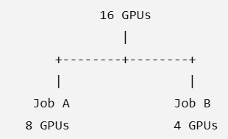
Resource management for production-scale machine learning
10. Resource Scheduling
One of the most important tasks is scheduling.
Suppose a cloud ML cluster has:
16 GPUs
and three jobs arrive:
Job A → 8 GPUs
Job B → 4 GPUs
Job C → 8 GPUs
The scheduler decides:

Slide 51
Resource management for production-scale machine learning
10. Resource Scheduling
Job C must wait until sufficient resources become available.
The scheduler considers:
Priority
Resource requirements
Deadline
Cost
Fairness
Availability

Slide 52
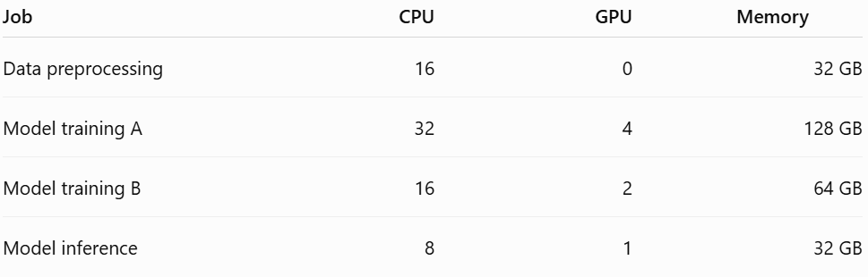
Resource management for production-scale machine learning
11. Resource Allocation
Resource allocation means deciding how much resource should be assigned to each ML workload.
For example:
The allocation should match the workload.
Giving 8 GPUs to a job that needs only 2 results in resource wastage.

Slide 53
Resource management for production-scale machine learning
12. Resource Isolation
Multiple ML workloads may run on the same infrastructure.
For example:
Cloud ML Cluster
|
+---- Team A
|
+---- Team B
|
+---- Team C
One workload should not consume all resources and negatively affect other workloads.

Slide 54
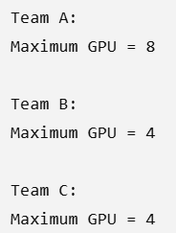
Resource management for production-scale machine learning
12. Resource Isolation
Isolation can be achieved using:
Containers
Kubernetes namespaces
Resource limits
CPU limits
Memory limits
GPU allocation
Quotas
E.g.

Slide 55
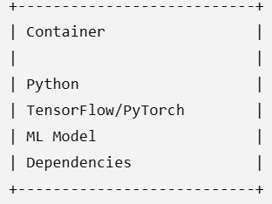
Resource management for production-scale machine learning
13. Container-Based Resource Management
ML applications are frequently packaged using containers.
For example:
Containers provide:
Isolation
Reproducibility
Portability
Resource limits
Easier deployment

Slide 56
Resource management for production-scale machine learning
13. Container-Based Resource Management
A container can be assigned limits such as:
CPU = 4 cores
Memory = 16 GB
GPU = 1

Slide 57
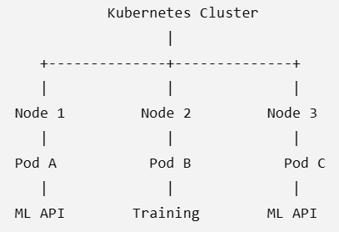
Resource management for production-scale machine learning
14. Kubernetes-Based Resource Management
For large production ML systems, Kubernetes can manage containers and workloads.
A simplified architecture is:

Slide 58
Resource management for production-scale machine learning
14. Kubernetes-Based Resource Management
Kubernetes can:
Schedule workloads
Restart failed containers
Scale applications
Allocate CPU/memory
Manage GPUs
Provide service discovery
Perform rolling deployments

Slide 59
Resource management for production-scale machine learning
15. Auto Scaling
Production ML services often have variable workloads.
For example:
Morning:
1,000 requests/minute
Afternoon:
10,000 requests/minute
Night:
500 requests/minute
Using a fixed number of servers would waste resources during low traffic.

Slide 60
Resource management for production-scale machine learning
15. Auto Scaling
Auto scaling solves this problem.
Low traffic
↓
2 instances
High traffic
↓
20 instances
When traffic decreases:
20 instances
↓
5 instances
This provides elasticity.

Slide 61
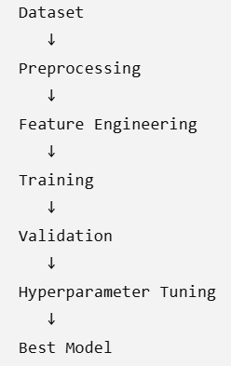
Resource management for production-scale machine learning
16. Training Resource Management
Training is usually resource-intensive.
A training pipeline may look like:

Slide 62
Resource management for production-scale machine learning
16. Training Resource Management
Each stage requires different resources.
For example:
Preprocessing → CPU + RAM
Training → GPU + RAM
Hyperparameter tuning → Many GPUs
Model evaluation → CPU/GPU
Good resource management prevents unnecessary resource consumption.

Slide 63
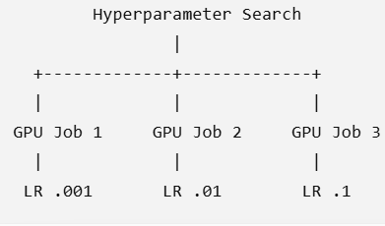
Resource management for production-scale machine learning
17. Hyperparameter Tuning
Suppose we need to test:
Learning rate = 0.001, 0.01, 0.1
Batch size = 32, 64, 128
Number of layers = 2, 4
There can be many combinations.
Cloud resources can run experiments in parallel:

Slide 64
Resource management for production-scale machine learning
17. Hyperparameter Tuning
However, running too many experiments simultaneously can become expensive.
Therefore, resource managers must control:
Number of concurrent jobs
GPU allocation
Maximum budget
Job priority

Slide 65
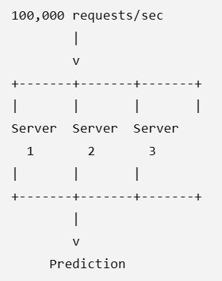
Resource management for production-scale machine learning
18. Inference Resource Management
After training, the model must serve predictions.
For example:

Slide 66
Resource management for production-scale machine learning
18. Inference Resource Management
Resource management must maintain:
Low latency
For example:
Prediction response < 100 ms
High throughput
For example:
100,000 requests/sec
High availability
The service should continue operating even if some servers fail.

Slide 67
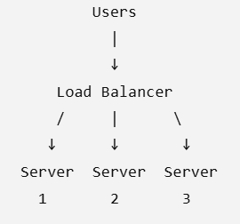
Resource management for production-scale machine learning
19. Load Balancing
When many inference servers are available, incoming requests should be distributed among them.
This prevents one server from becoming overloaded.

Slide 68
Resource management for production-scale machine learning
20.Resource Monitoring
What is Resource Monitoring?
Resource monitoring means continuously observing how the resources of an ML system are being used.
In production ML, we monitor:
CPU utilization
GPU utilization
Memory usage
Storage usage
Network bandwidth
Number of requests
Prediction/inference latency
Error rate
Number of active servers

Slide 69
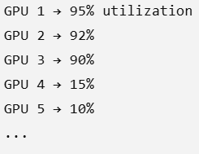
Resource management for production-scale machine learning
20.Resource Monitoring
Why is monitoring necessary?
Suppose we have 10 GPUs:
Some GPUs are heavily loaded while others are almost idle.
Monitoring helps identify this imbalance and allows the system administrator or scheduler to redistribute workloads.

Slide 70
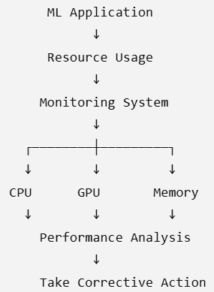
Resource management for production-scale machine learning
20.Resource Monitoring
Monitoring in ML production
A simplified process is:

Slide 71
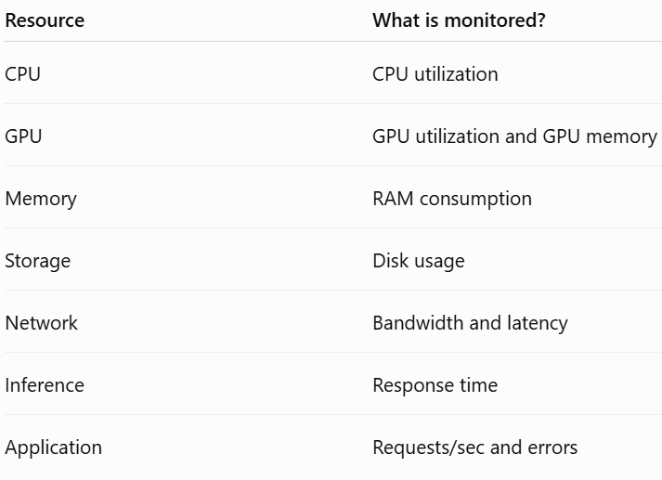
Resource management for production-scale machine learning
20.Resource Monitoring
For example:
If GPU utilization becomes very high, additional GPU instances can be started.
If traffic decreases, unnecessary instances can be stopped.

Slide 72
Resource management for production-scale machine learning
20.Resource Monitoring
Example
An ML prediction service normally handles:
500 requests/second
During peak traffic:
500 → 5,000 requests/second
Monitoring detects:
CPU = 95%
GPU = 98%
Latency = increasing
The system can then trigger auto-scaling.

Slide 73
Resource management for production-scale machine learning
21. Cost Optimization
Production ML can be expensive because it may require:
GPUs
High-performance CPUs
Large storage
High network bandwidth
Multiple servers
Cloud services
Therefore, resource management should not only focus on performance—it should also focus on cost.
We want Maximum performance with minimum unnecessary resource consumption.

Slide 74
Resource management for production-scale machine learning
21. Cost Optimization
For example:
Without optimization:
10 GPUs
↓
Only 40% utilized
↓
High cost
Instead:
Resource optimization
↓
5 GPUs
↓
80% utilization
↓
Lower cost

Slide 75
Resource management for production-scale machine learning
21. Cost optimization:
Techniques for cost optimization
1. Right-sizing
Allocate only the resources actually required.
For example:
Required:
4 CPUs + 1 GPU
Instead of:
16 CPUs + 4 GPUs
This prevents over-provisioning.

Slide 76
Resource management for production-scale machine learning
21. Cost optimization:
Techniques for cost optimization
2. Auto-scaling
Increase resources when demand increases and reduce them when demand falls.
Low demand
↓
2 servers
High demand
↓
10 servers
Demand decreases
↓
3 servers
This prevents paying for unused infrastructure.

Slide 77
Resource management for production-scale machine learning
21. Cost optimization:
Techniques for cost optimization
3. Remove idle resources
Sometimes a GPU or server is allocated to a job but remains unused.
Example:
GPU allocated
↓
Training job finished
↓
GPU still running
↓
Money is wasted
The resource should be released after the job finishes.

Slide 78
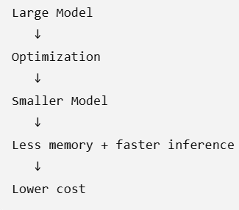
Resource management for production-scale machine learning
21. Cost optimization:
Techniques for cost optimization
4. Model optimization
A large ML model may require significant computing power.
Techniques such as:
Quantization
Pruning
Knowledge distillation
Model compression
can reduce resource requirements.
Example:

Slide 79
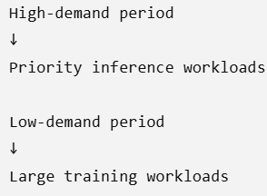
Resource management for production-scale machine learning
21. Cost optimization:
Techniques for cost optimization
5. Efficient scheduling
Non-urgent ML training jobs can be scheduled when resources are cheaper or more available.
For example:
This improves infrastructure utilization.

Slide 80
Resource management for production-scale machine learning
21. Cost optimization:
Techniques for cost optimization
5. Efficient scheduling
Example of cost optimization
Suppose a company uses:
20 GPUs
₹200/hour/GPU
Cost per hour:
20 × ₹200 = ₹4,000/hour
If monitoring shows that only 10 GPUs are needed during low-demand periods:
20 GPUs → 10 GPUs
Cost becomes:
10 × ₹200 = ₹2,000/hour
So resource optimization can significantly reduce infrastructure costs.

Slide 81
Resource management for production-scale machine learning
22.Challenges in Resource Management
Managing resources for production-scale ML is difficult because workloads are large, dynamic, distributed, and unpredictable.
1. Resource underutilization
Resources may be available but unused.
Example:
GPU capacity = 100%
Actual utilization = 30%
The organization is paying for resources that are not being fully used.

Slide 82
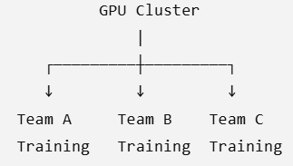
Resource management for production-scale machine learning
22.Challenges in Resource Management
2. Resource contention
Multiple ML jobs may compete for the same resources.
Example:
If all require GPUs simultaneously, there may not be enough GPUs.
This is called resource contention.

Slide 83
Resource management for production-scale machine learning
22.Challenges in Resource Management
3. Workload variability
ML workloads are not always constant.
For example:
Morning → Low traffic
Afternoon → Medium traffic
Evening → High traffic
Night → Low traffic
The infrastructure must adapt to these changes.

Slide 84
Resource management for production-scale machine learning
22.Challenges in Resource Management
4. GPU scarcity
Large ML models may require many GPUs.
However, GPUs are expensive and may be limited.
Therefore, the scheduler must decide:
Which ML job should receive the available GPUs?

Slide 85
Resource management for production-scale machine learning
22.Challenges in Resource Management
5. Memory limitations
Large models can require enormous amounts of memory.
If the available memory is insufficient:
Large Model
↓
Memory requirement > Available memory
↓
Training failure / Out-of-memory error

Slide 86
Resource management for production-scale machine learning
22.Challenges in Resource Management
6. Distributed-system complexity
Large-scale ML may run across many machines.
Machine 1 ── GPU
Machine 2 ── GPU
Machine 3 ── GPU
Machine 4 ── GPU
↓
Distributed Training
These machines need to communicate and synchronize.
Problems such as:
Network delays
Machine failures
Synchronization overhead
Data transfer
can reduce performance.

Slide 87
Resource management for production-scale machine learning
22.Challenges in Resource Management
7. Fault tolerance
Machines can fail during long-running training jobs.
For example:
Training
↓
40% complete
↓
GPU server fails
↓
Training interrupted
The system should ideally recover using checkpoints rather than starting from the beginning.

Slide 88
Resource management for production-scale machine learning
22.Challenges in Resource Management
8. Balancing performance and cost
This is one of the biggest challenges.
More resources generally provide better performance, but increase cost.
More GPUs
↓
Faster training
↓
Higher cost
The goal is to find the right balance:
Performance ↔ Cost

Slide 89
Resource management for production-scale machine learning
22.Challenges in Resource Management
9. Scalability
The ML system must continue working when the workload grows.
For example:
100 users
↓
1,000 users
↓
100,000 users
↓
Millions of users
The infrastructure must scale accordingly.

Slide 90
Resource management for production-scale machine learning
22.Challenges in Resource Management
10. Energy consumption
Large GPU clusters consume significant electricity.
Therefore, organizations increasingly consider:
Efficient hardware utilization
Turning off idle resources
Efficient model architectures
Scheduling workloads efficiently
to reduce energy consumption.

